Slide 1
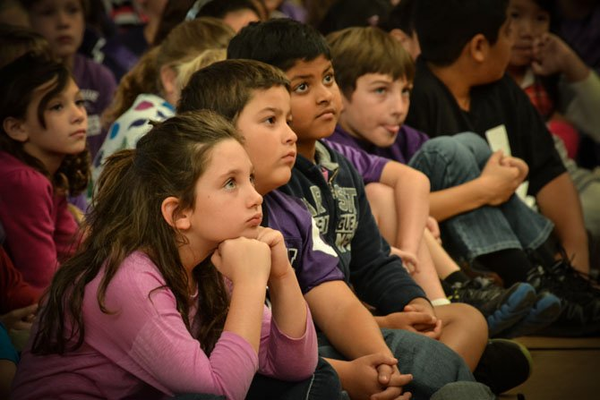
October 16, 2017
Meeting called to order @ 7:02 PM.
Meeting notes in red.

Slide 2
Attendance
Kay Shear
Julie Chang
Joanne Fulmer
Stephanie Kohne
Allison Wehnueller
Stephanie Baez
Michelle Denny
Brittany Poole
Cristina Doughtery
Bob D’Amato
VaRonica Sloan
Ms. Tapper
Kristen Lynch
Vicki McGorty
Lisa Tilley
Kelly D’Sheilds
Christine Pimentel

Slide 3
Agenda
Principal’s Report
Presidents Report
Membership and Pledge Program
Dining Days, Hallowingo, Book Fair
Other events
After School Programs update
Treasurer’s Report
Budget vs. Actual

Slide 4
Principal/School Report
Fun, Fit, Friday!
250+ people last Friday!
6th grade Hemlock trip was a success!
Trail from school to townhomes - update: patchy part of trail will be lined and filled with crushed gravel. Dave Trumble is getting quotes.
School Improvement Innovation Plan (SIIP)
1 – “raise the bar”. Goal: writing
Students & teachers took emoji survey about writing
Want to improve score from emoji survey
2 – science scores dropped to an 83 last year (above state standard).
STEAM working closely with 5th graders who take the science SOL & curriculum
Crunching numbers and researching data
Goal: increase scores by 10%

Slide 5
Principal/School Report
Ms. Poole, literacy team (works with struggling readers and writers)
Kick off TODAY! “The One and Only Ivan” – readers K – 6 grades.
“One school, one book” initiative – over 450 students participating (over 300 families.)
Paper copy and KIT: reading schedule and discussion questions.
Contact Ms. Poole if you need information.
Principals’ Trivia: answers go in the tub in the library – winners picked on Fridays.
If successful: next year - one book in the fall, one book in the spring.
ReadToThem.org
All teachers have the book to read aloud to the entire class.
Parent-Teacher Conferences
Nov. 6th – Professional Development Day, Nov. 7th – Planning Day.
-County regulation: teacher must hold conferences before the winter break.

Slide 6
Principal/School Report
Ms. Sloan
Universal Screener update
Fall results shared during parent-teacher conferences
Placement levels
Domains in reading and math
Mr. D’Amato
Dyslexia Awareness and Cancer Awareness Month of October
Teachers: professional development
Next Thursday – wear PINK!
Staff member is currently battling cancer. Wear pink in her honor.
Social networks:
Twitter, Blooms, grade-level newsletters

Slide 7
Principal/School Report
Ms. Tapper
KIT: sent out every Friday around 2:30 p.m.
Showcases LCES: twitter page, school marquee
Twitter: @Lees_Corner_ES
No students names or grade levels are disclosed.
Goal: engage community
Hurricane Harvey Fundraiser update
Raised over $13K regionally!

Slide 8
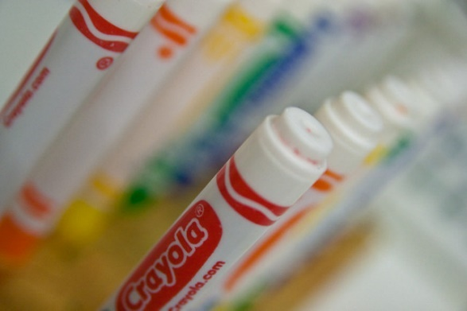
Colorcycle
Last June, LC students and teachers kept 2,186 markers out of landfills! Close to 1,000 markers that were deposited in the ColorCycle boxes were still in good working condition so they were donated to a classroom with a need for markers. The teacher also joined the program and promised that when they were no longer usable she would mail them off to Crayola. Two great causes came out of our collection.
This year the PTA put collection boxes in the teacher lounges. The PTA and the Special Ed department decided to work together to continue turning used markers into energy! The markers will be sent to a facility where they will be converted into clean fuel. This fuel can be used to power vehicles, heat homes, cook meals and more!
The PTA donated small plastic dollar store trash cans with lids. This will allow us to put 1 in each classroom, teacher’s lounge, office, health room, etc. This will make it easier for the students to discard their markers as soon as they are used up instead of having staff take them to the lounge. Each trash can will have the ColorCycle logo on it. If possible please put it near the regular trash can as visual reminder for students.
The PTA will put out larger bins at school functions and ask parents to bring in any used markers.
There are six 6th graders in the self-contained special education classes who are in need of service hours. They will be earning their hours by collecting the markers at the end of each month, counting them, and boxing them up for delivery at Fed Ex. The data they collect (how many markers are kept out of landfills) will be given to Tina Pivarnik. She will use this information for our Eco School program.
ANY TYPE OF MARKER CAN BE DEPOSITED. IT DOES NOT HAVE TO BE A CRAYOLA MARKER.
There will be collection bins at Hallowingo!! Please test your markers and bring in the dried up ones.

Slide 9
PTA Report
School Bond Referendum
Membership
Not too late to join!
Membership perk: free Hallowingo tickets for your family!
After School Programs
Feedback regarding activities is welcome.
Hallowingo
Volunteers must be 7th grade or older. Sign up on PTAvenue.
Need more volunteers to bring in baked goods.
An adult must be at all stations.
The playground is CLOSED during Hallowingo!

Slide 10
PTA Report
Book Fair
New books for your home library, holiday gifts.
Purchase during school hours and family night.
Support your classroom library.
Dining Days
Chick-Fil-A – we earned $500 (their maximum).
6th Grade Basketball vs. Oak Hill
Lunch room Volunteers
Need four more parents to assist in the lunchroom. Please contact a PTA officer or the office.

Slide 11
PTA Report
Grocery receipts
Giant: 256 people have registered their cards.
Might have to re-register in the future.
Harris Teeter: 21 people registered.
AmazonSmile: No reports available.
Certifikid: use code: LCES for $5 off and $5 for LCES!
One time use only.
Directory
Need volunteer to label and distribute printed directory to teacher boxes.
Date to follow.
Box Tops
1st contest of the year is complete!
$351.60! Winners announced tomorrow! Prize: “PJ Day”!

Slide 12
PTA Report
Fairfax County PTA
New committee for Special Education
LCES PTA is requesting parent involvement who has experience in this area to provide input on PTA $ allotment, awareness, decision-making and respresentation.
Please contact a PTA board member to provide assistance.

Slide 13
2017 School Bond Referendum
https://www.youtube.com/watch?v=BXNs5EiEjfs
What is a Bond? The sale of municipal bonds is a form of long-term borrowing that spreads the cost of major capital improvements over the years facilities are used. This method of financing ensures that current and future users help pay for the improvements.
Why are Bonds Needed? The building and renovation of schools are not financed through the school system’s operating funds, but through bonds. Similar to an individual or a family obtaining a mortgage on a residence to spread the cost of home buying over a number of years, bonds spread the cost of major capital improvements over a number of years. If approved, these bonds will probably be sold to large investment banking syndicates that will have to competitively bid for them. Once bought, they are typically resold to financial institutions, which then sell them to investors.
Why a Referendum? The law requires that voters approve bonds since they are a future obligation for taxpayers. As long as debt service costs do not increase significantly as a percentage of combined general fund disbursements, the county’s bonded debt will not be a contributing factor to any increase in local taxes.
View a list of school improvement projects included in the 2017 Bond Referendum https://www.fcps.edu/about-fcps/facilities-planning-future/2017-school-bond-referendum/school-improvement-projects \
A school bond referendum will be on the general election ballot Tuesday, November 7, 2017. Polls will be open from 6 a.m. to 7 p.m.

Slide 15
Membership
Families* | Faculty/Staff* | Total
237 | 52 | 289
We are slightly over (by 6 memberships) from last year. Families are up by 8 and faculty is down by 2. Membership was mentioned last week in the KIT, and we saw a couple memberships as a result of that.

Slide 16
After School Programs
2 class were cancelled, Game Design for 1st-4th graders; Flag Football for 4-6th (but Flag Football still ran for the K-3rd group)
Sign ups for everything else was great. 12 classes filled. Last group of starts begin this week (week of October 10th).
Will start lining up the winter activities in the next few weeks.

Slide 17
Hallowingo
Friday October 27 from 6-9pm.
The event is free for PTA pledged members. For non-PTA pledged members, the cost to enter is $10 per family.
We will be selling pizza, soda and baked goods. There will be dancing in the gym and Bingo in the cafeteria.
Each classroom has a parent representative who is putting together a class basket, theme of their choice. Tickets can be purchased to enter a raffle for the basket of your choice. The drawing for the baskets will happen towards the end of the evening.
We need volunteers to bake cookies, brownies, cupcakes or rice crispy treats. Please no nuts and please individually wrap each item so it is ready to sell. Either with two cookies in a bag, etc. And a few other volunteer slots are open, please sign up at PTAvenue.com.
Please email Kellydeshields@gmail.com if you wish to volunteer or have questions about the event. We look forward to seeing you!

Slide 18
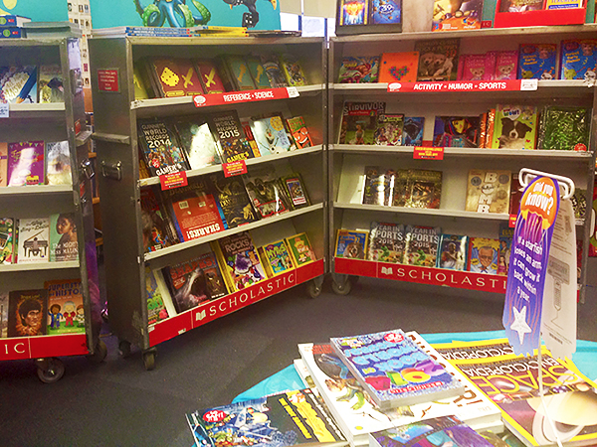
Book Fair
November 13-17, 2017
Family night is Wednesday, Nov 15
4-8PM
Open during Thanksgiving luncheon on Thursday, Nov 16
Questions? Contact Teresa Fletcher tlfletcher2@gmail.com

Slide 19
Dining Days
Chick-fil-A earned us $500!!
The next dining day: Tuesday December 5 at MOD pizza in Greenbriar.
MOD will give 20% of purchases all day to anyone who shows a printed or digital flyer.
Must have the Lees Corner flyer to give credit to the school.
Look for that flyer to go out sometime in mid to late November.

Slide 20
6th Grade Basketball
Save the date! March 9, 2017
Identify coaches and schedule practices
Meet with Oak Hill to decide on half time games and coordinate the event
Please contact Julie Chang if you’re interested in helping. We will need LOTS of volunteers!

Slide 21
Budget vs. Actual
Lees Corner PTA
2017 - 2018 Budget vs. Actuals
 |  |  | Budget | Actuals | Variance
2000 Sources of Income (Net)
 | Dues |  | $ 14,000 | $ 17,630 | $ 3,630
 | Donations |  | $ 1,000 |  | $ (1,000)
 | Fundraising |  |  |  | $ -
 |  | Hallowingo | $ 7,500 |  | $ (7,500)
 |  | Spirit Wear | $ 1,000 |  | $ (1,000)
 |  | Dining Days | $ 1,000 | $ 500 | $ (500)
 |  | Grocery Receipts | $ 5,500 |  | $ (5,500)
 |  | Box Top Program/School-Pak | $ 400 | $ 142 | $ (258)
 |  | 6th Grade Basketball Game | $ 3,700 |  | $ (3,700)
 | Extra Curricular Activities
 |  | Overtime Athletics | $ 3,700 |  | $ (3,700)
 |  | After School Programs | $ 500 | $ 7,369 | $ 6,869
 |  | Book Fair | $ 3,000 |  | $ (3,000)
Total Sources of Income |  |  | $ 41,300 | $ 25,641 | $ (15,659)
 |  | Balance Brought Forward from PY | $ 28,750
Total Source of Income (including PY Funds) |  |  | $ 70,050 | $ 25,641 | $ (15,659)
* Balance in reserve account $25,305

Slide 22
Budget vs. Actual
4000 Expenses
 | Fundraising
 |  | Membership | $ 300 | $ 139 | $ (161)
 |  | Hallowingo | $ 4,200 | $ 2,766 | $ (1,434)
 | Total Fundraising Expense |  | $ 4,500 | $ 2,905 | $ (1,595)
 | Committee
 |  | Cultural Arts | $ 3,000 | $ 1,000 | $ (2,000)
 |  | Music | $ 1,000 |  | $ (1,000)
 |  | Library Enrichment | $ 4,000 |  | $ (4,000)
 |  | After School Clubs | $ 1,000 |  | $ (1,000)
 |  | Grounds Beautification | $ 2,000 |  | $ (2,000)
 |  | Outdoor Classroom Maintenance | $ 4,000 |  | $ (4,000)
 |  | 6th Grade Basketball Game | $ 2,000 |  | $ (2,000)
 |  | 6th Grade Luncheon | $ 3,000 |  | $ (3,000)
 |  | Teacher Appreciation | $ 3,500 | $ 409 | $ (3,091)
 | Total Committee Expenses |  | $ 23,500 | $ 1,409 | $ (22,091)

Slide 23
Budget vs. Actual
 | Program
 |  | Computing | $ 6,300 |  | $ (6,300)
 |  | STEAM program | $ 10,000 | $ 131 | $ (9,869)
 |  | School Outings/Field Trips | $ 8,100 |  | $ (8,100)
 |  | Periodicals | $ 2,700 |  | $ (2,700)
 |  | Physical Education & Health | $ 2,700 |  | $ (2,700)
 |  | Leadership Development (Teacher Training) | $ 3,500 |  | $ (3,500)
 |  | Positive Behavior (PBIS) | $ 900 |  | $ (900)
 | Total Program Expenses |  | $ 34,200 | $ 131 | $ (34,069)
 | Other |  | $ - |  | $ -
 |  | Gifts Given | $ 300 |  | $ (300)
 |  | Principal Flex Fund | $ 1,000 | $ 458 | $ (542)
 |  | Teacher Stipends | $ 2,500 | $ 2,500 | $ -
 | Total Other Expenses |  | $ 3,800 | $ 2,958 | $ (842)
 | Overhead
 |  | Admin & Supplies | $ 900 | $ 262 | $ (638)
 |  | Insurance | $ 350 |  | $ (350)
 |  | Bank Charges | $ 1,000 | $ 395 | $ (605)
 |  | PTA Dues | $ 1,300 |  | $ (1,300)
 |  | Tax Preparation | $ 500 |  | $ (500)
 | Total Overhead Expenses |  | $ 4,050 | $ 657 | $ (3,393)
Total Expenses |  |  | $ 70,050 | $ 8,059 | $ (61,991)
Net Use of Funds |  |  | $ (0) | $ 17,582 | $ 46,332

Slide 24
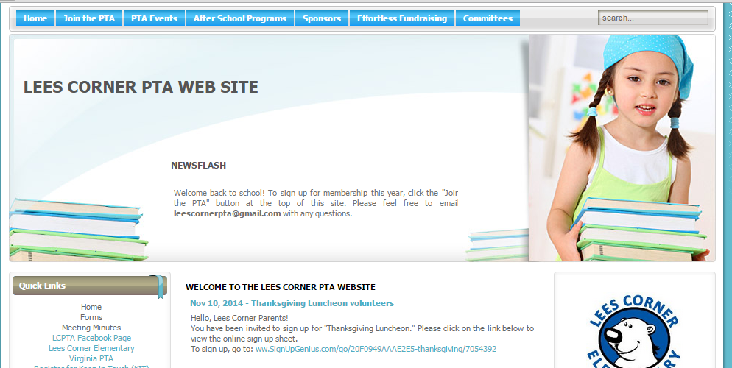
Resources
Please visit www.leescornerpta.org
Meeting materials will be posted on the home page in the next few days, including the link for the recorded live stream.
Join our Facebook group! It is a closed group so only the school community can join and posts are not available to the general public. https://www.facebook.com/groups/673851072716338/

Slide 25
Adjourned @ 7:55 PM 1st – Julie change 2nd – Joanne Fulmer
Next meeting: Monday, November 13
Same time, same place!

