Slide 1
Happy New Year and Happy Snow Day!
January 8, 2018

Slide 2
Principal/School Report
An update on Professional Development will be provided at the next meeting.

Slide 3
PTA Report
6th Grade Basketball vs. Oak Hill
After School Programs
Blizzard’s Market
Special Education
Effortless Fundraising
Dining Days
Treasurer’s Report

Slide 4
6th Grade Basketball, March 9
The annual 6th Grade Lees Corner vs. Oak Hill Basketball Game is scheduled for Friday, March 9, 2018! This event is fun for the whole family!
6th graders can cheer, play basketball and play in the pep band
5th graders can cheer and play in the pep band
4th graders can cheer
Permission forms due Jan 18!
Parents: If you're interested in helping out, please send an email to julieohmchang@gmail.com.

Slide 5
After School Programs
Soccer, K-3, Monday - 15 registered, will run
Bulls and Bears, 3-6, Monday - no kids signed up yet
Science Exploratorium, K-2, Monday - only 3 kids registered
MC Redstone, 1-4, Monday - will run
Cheerleading, K-6, Tuesday - only 4 kids registered
Builders, 3-6, Tuesday - only 3 kids registered
Website Design, 3-6, Tuesday - 8 kids registered, need a few more to run
Lego Astronaut, K-3, Tuesday - only 4 registered
Soccer, 4-6, Wednesday - only 3 kids registered
Doodlers, K-6, Wednesday - only 4 registered
Zumba, K-5, Wednesday - only 3 registered
Sensational Science, K-6, Wednesday - only 1 registered
Coding, 2-6, Thursday - 10 registered, will run
Star Wars, K-3, Thursday - only 3 registered
Star Wars, 4-6, Thursday - only 3 registered
Speakers Club, 3-6, Thursday - only 2 registered
Chess, K-6, Friday - 7 registered, will run

Slide 6
Established Fall 2016

Slide 7
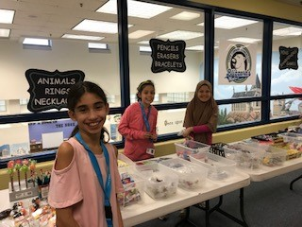
The store is run by students in 5th grade and special education classrooms. It is supervised by Mrs. Filgueira. The goal is to provide a wonderful learning opportunity that promotes academics and social interaction.

Slide 8
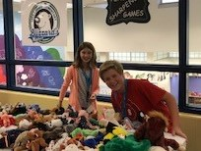
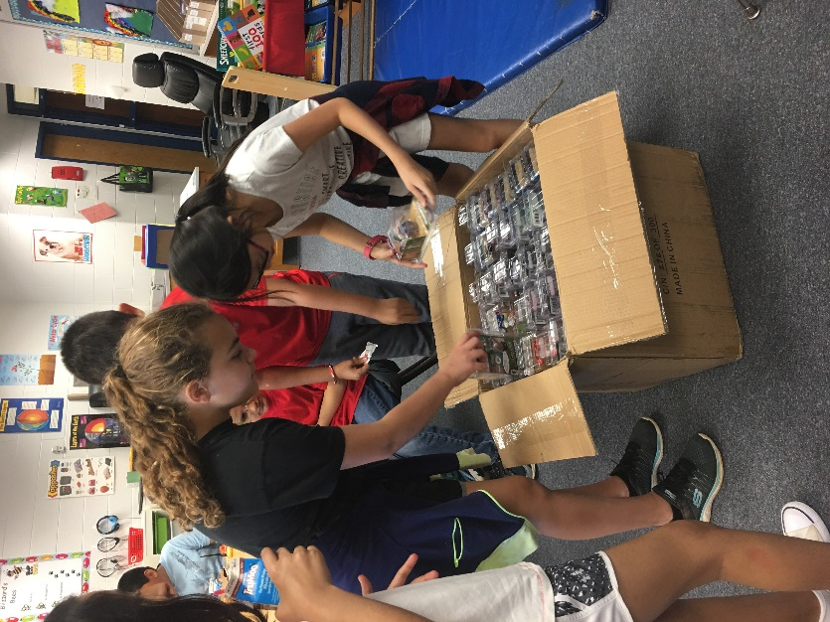
Blizzard’s Market is a true-to-life situation, incorporating teamwork, responsibilities, management, and academic areas.

Slide 9
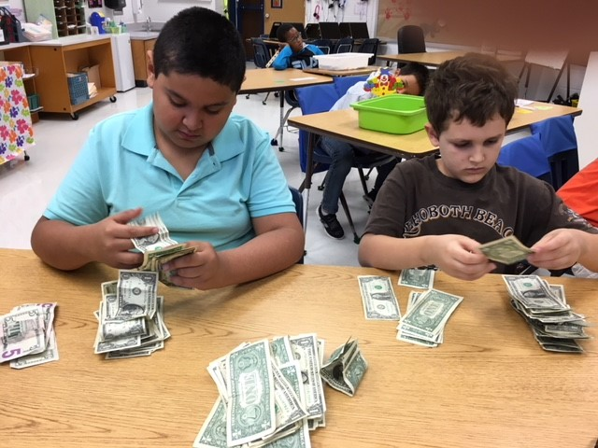
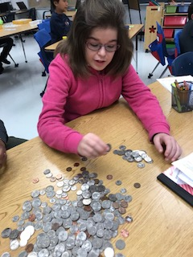
Math and banking skills

Slide 10
Blizzard’s Market staff learn about the ordering process and the difference between wholesale and retail.

Slide 11
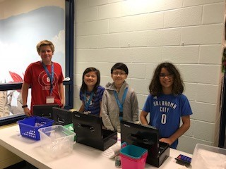
Positions have been created from manager down to sales clerks so that students can see what is involved in operating a business. CASHIERS Students are given practical experience in making change with real money in addition to using learned math skills.

Slide 12
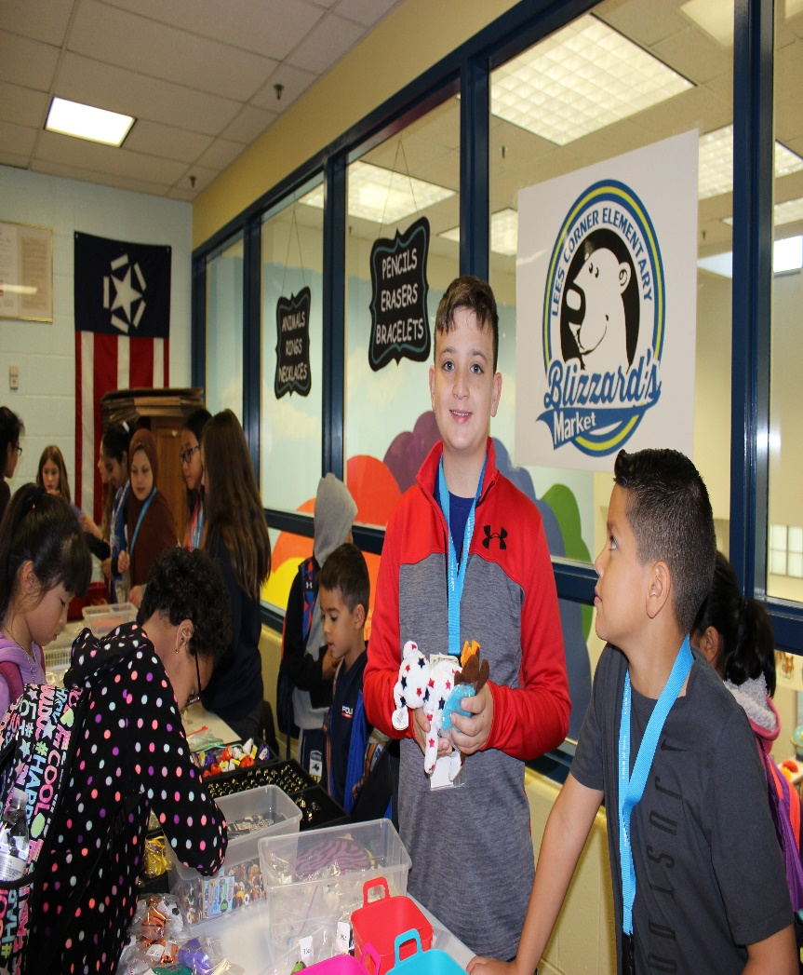
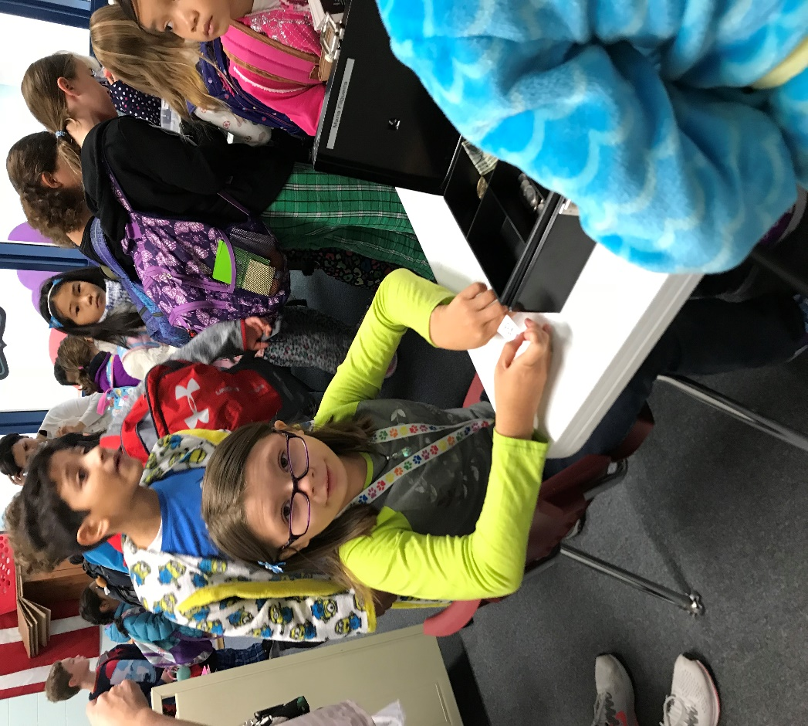
SALES CLERKS

Slide 13
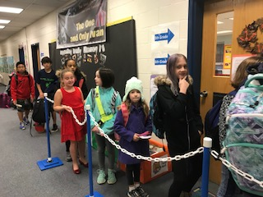
Line monitors keep the line moving to ensure students arrive to class on time.

Slide 14
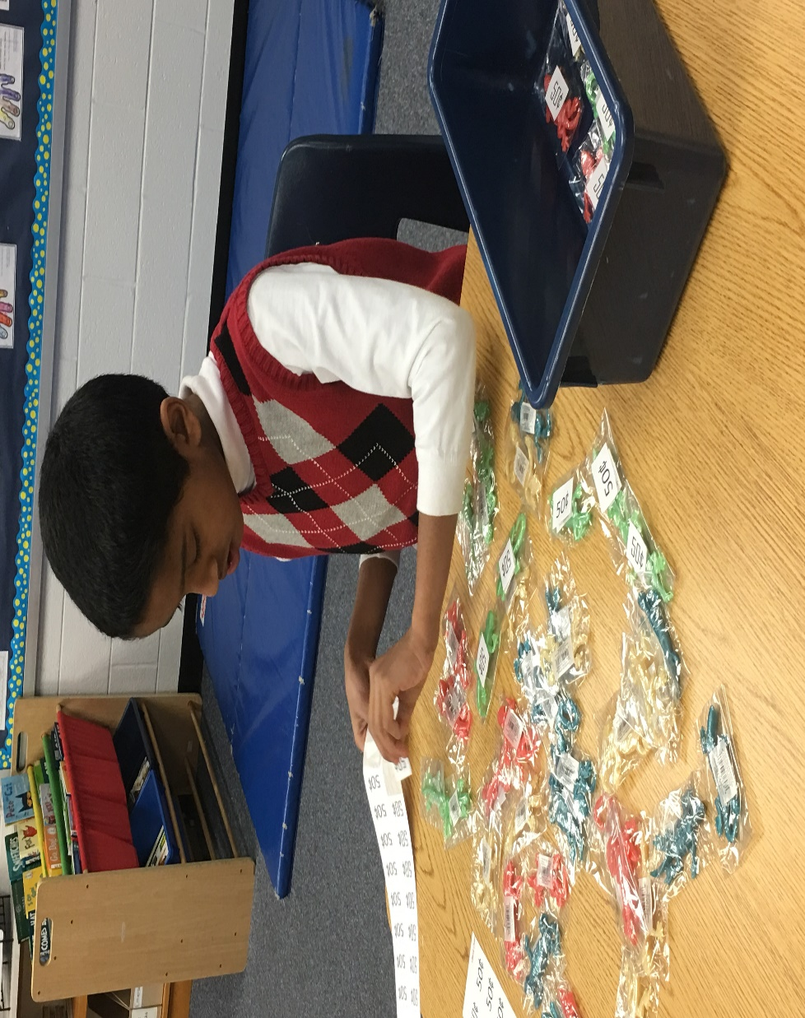
Staff pricing each item to help check out.

Slide 15
Blizzard’s Market staff packaging bulk items into individual bags.

Slide 16
What do we do with the profits? All profits are used to enhance programs at Lees Corner.
Speech and Language
Occupational Therapist
Adapted Physical Education
Enhanced Autism classrooms
School wide PBIS program
Blizzard’s Bee initiative
The One and Only Ivan …….

Slide 17
Lees Corner’s Positive Behavioral Intervention and Supports program (PBIS)
Blizzard’s Market profits purchase the items for the PBIS cart. When a class reaches 250 and 450 bears they earn a visit from Mr. D’Amato, Ms. Sloan or Mrs. Tapper and the PBIS cart. Each student in the classroom is able to select 1 item from the cart.

Slide 18
Brag Tags
This school year every student at Lees Corner will be given a key chain and have the opportunity to collect Brag Tags.
The PBIS cart will have a variety of different Brag Tags for students to pick.
Classroom and specialist have chosen a Brag Tag that represents them or the special they teach.
Brag Tags will also be for sale at Blizzard’s Market.
All 784 key chains and brag tags were purchased with profits from Blizzard’s Market.

Slide 19
Quick peek at 1 Brag Tag.

Slide 20
Golden Tickets
Blizzard’s Market profits are used to purchase Golden Tickets for all Lees Corner staff to give to students who they “catch” being a Blizzard’s Bee.

Slide 21
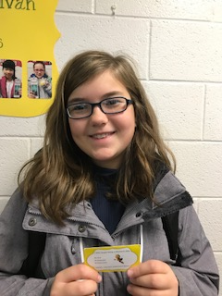
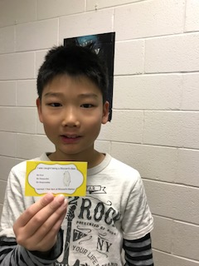
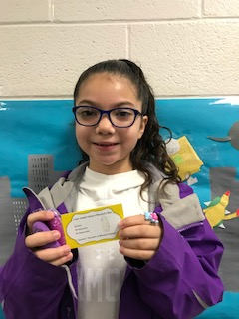
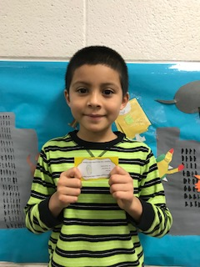
Golden Ticket holders…..

Slide 22
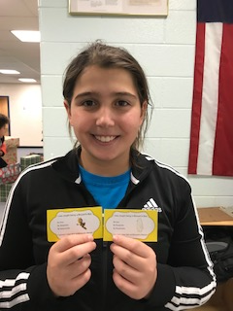
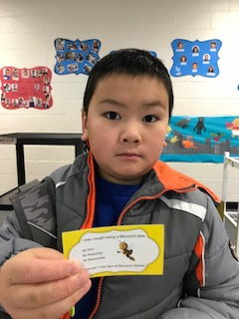
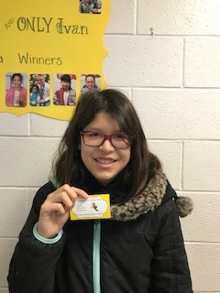
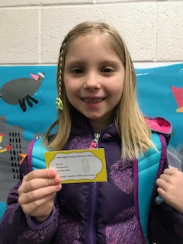
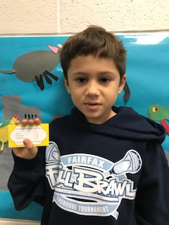

Slide 23
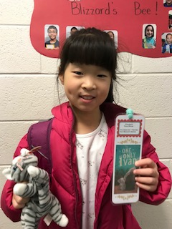
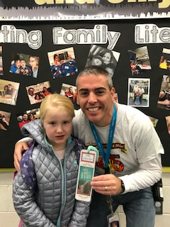
The One and Only Ivan school wide reading program. A weekly drawing was held and the winners each received 1 free item from Blizzard’s Market.

Slide 24
PTA Special Education Representative
WEDNESDAY, January 24 from 6:30-9 pm - Please join Fairfax County SEPTA for our General Membership Meeting and a Workshop with Melanie Kaplan, LCSW; "I Have Needs, Too! Supporting the Siblings of Children with Special Needs." Location: Chantilly High School
Upcoming Events…
Fairfax County Sheriff’s Department will provide Free Fingerprinting and ID Card to any Lees Corner students who have permission and would like to participate (Date TBD)

Slide 25
This is an excellent way to shop online or via your phone and Lees Corner PTA will receive 2-10% of your purchase just from using the app to pay. More than 160 participating vendors that include Amazon (2%), Apple iTunes (5%), Bed, Bath and Beyond (7%), Boston Market (10%), Regal Theaters (8%), Starbucks (5%), Target (2.5%), Whole Foods (2.5%), and many more!
Download the app onto your iPhone or Android.
Link it to a credit card or bank account.
When you are checking out either online or in the store, pull up the app, choose the store from the retailer menu and simply key in the amount. The app instantly creates a gift card code that can be used either at the store or online.

Slide 26
Fundraising Summary
Fundraising Program | Enrolled | Nov/Dec 2017 Actual Amount | Budget (2017-18)
 | 259 | $1920
 | 26 | $131
 | N/A | $1087*
 | 2 | $58
 | 3 | $15
 | N/A | $0
Totals |  | $3,211 (58% of goal) | $5500

Slide 27
Dining Days
MOD Pizza dining days on December 5 was a huge success. We raised $484.55.
Thank you to all who came out to eat pizza and salads.
The next dining days will be in the Spring!

Slide 28
Treasurer’s Report
Budget vs Actual

Slide 29
Budget vs. Actual
Lees Corner PTA
2017 - 2018 Budget vs. Actuals
 |  |  | Budget | Actuals | Variance
2000 Sources of Income (Net)
 | Dues |  | $ 14,000 | $ 18,330 | $ 4,330
 | Donations |  | $ 1,000 | $ 500 | $ (500)
 | Fundraising |  | $ 400 | $ 149 | $ (251)
 |  | Hallowingo | $ 7,500 | $ 8,571 | $ 1,071
 |  | Spirit Wear | $ 1,000 | $ 1,413 | $ 413
 |  | Dining Days | $ 1,000 | $ 753 | $ (247)
 |  | Grocery Receipts | $ 5,500 | $ 309 | $ (5,191)
 |  | 6th Grade Basketball Game | $ 3,700 |  | $ (3,700)
 | Extra Curricular Activities
 |  | Overtime Athletics | $ 3,700 | $ 6,249 | $ 2,549
 |  | After School Programs | $ 500 | $ 322 | $ (178)
 |  | Book Fair | $ 3,000 | $ 3,369 | $ 369
Total Sources of Income |  |  | $ 41,300 | $ 39,964 | $ (1,336)
 |  | Balance Brought Forward from PY | $ 28,750
Total Source of Income (including PY Funds) |  |  | $ 70,050 | $ 39,964 | $ (1,336)
* Balance in reserve account $25,305

Slide 30
Budget vs. Actual
4000 Expenses
 | Fundraising
 |  | Membership | $ 300 | $ 521 | $ 221
 |  | Hallowingo | $ 4,200 | $ 4,105 | $ (95)
 | Total Fundraising Expense |  | $ 4,500 | $ 4,626 | $ 126
 | Committee
 |  | Cultural Arts | $ 3,000 | $ 1,000 | $ (2,000)
 |  | Music | $ 1,000 |  | $ (1,000)
 |  | Library Enrichment | $ 4,000 |  | $ (4,000)
 |  | After School Clubs | $ 1,000 |  | $ (1,000)
 |  | Grounds Beautification | $ 2,000 |  | $ (2,000)
 |  | Outdoor Classroom Maintenance | $ 4,000 |  | $ (4,000)
 |  | 6th Grade Basketball Game | $ 2,000 |  | $ (2,000)
 |  | 6th Grade Luncheon | $ 3,000 |  | $ (3,000)
 |  | Teacher Appreciation | $ 3,500 | $ 409 | $ (3,091)
 | Total Committee Expenses |  | $ 23,500 | $ 1,409 | $ (22,091)

Slide 31
Budget vs. Actual
 | Program
 |  | Computing | $ 6,300 |  | $ (6,300)
 |  | STEAM program | $ 10,000 | $ 131 | $ (9,869)
 |  | School Outings/Field Trips | $ 8,100 |  | $ (8,100)
 |  | Periodicals | $ 2,700 |  | $ (2,700)
 |  | Physical Education & Health | $ 2,700 | $ 222 | $ (2,478)
 |  | Leadership Development (Teacher Training) | $ 3,500 | $ 3,534 | $ 34
 |  | Positive Behavior (PBIS) | $ 900 | $ 96 | $ (804)
 | Total Program Expenses |  | $ 34,200 | $ 3,983 | $ (30,217)
 | Other |  | $ - |  | $ -
 |  | Gifts Given | $ 300 |  | $ (300)
 |  | Principal Flex Fund | $ 1,000 | $ 551 | $ (449)
 |  | Teacher Stipends | $ 2,500 | $ 2,500 | $ -
 | Total Other Expenses |  | $ 3,800 | $ 3,051 | $ (749)
 | Overhead
 |  | Admin & Supplies | $ 900 | $ 527 | $ (373)
 |  | Insurance | $ 350 |  | $ (350)
 |  | Bank Charges | $ 1,000 | $ 489 | $ (511)
 |  | PTA Dues | $ 1,300 | $ 1,168 | $ (132)
 |  | Tax Preparation | $ 500 |  | $ (500)
 | Total Overhead Expenses |  | $ 4,050 | $ 2,184 | $ (1,866)
Total Expenses |  |  | $ 70,050 | $ 15,253 | $ (54,797)
Net Use of Funds |  |  | $ (0) | $ 24,711 | $ 53,461

Slide 32
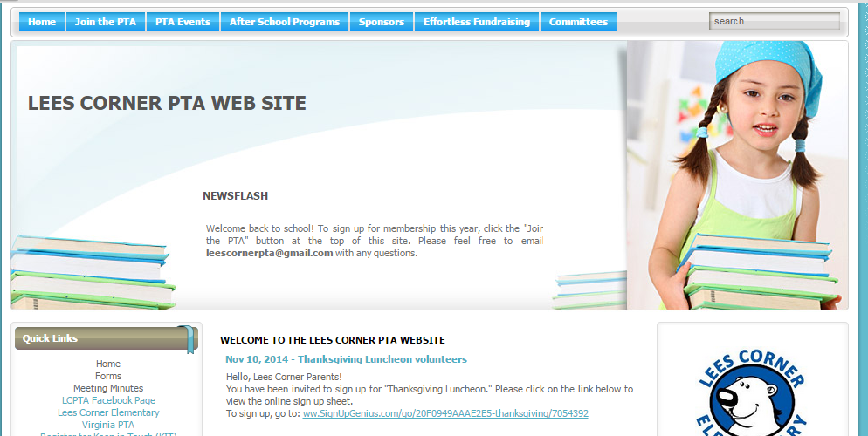
Resources
Meeting materials will be posted on the home page in the next few days, including the link for the recorded live stream.
Join our Facebook group! It is a closed group so only the school community can join and posts are not available to the general public. https://www.facebook.com/groups/673851072716338/

Slide 33
Adjourn
Next meeting: Monday, February 12, 2018

