Slide 1
LCES Students @ Barnes and Noble
June 11, 2018
Some notes are below the slides in the “notes” box.
Meeting minutes in RED.
Meeting called to order at 8:03 PM

Slide 2
Attendance
Kay Shear
Julie Chang
Joanne Fulmer
Bob D’Amato
Laura Tapper
Christine Pimentel
Jon Hill
Simi Sitaram
Tracy Kagan
Amy Whiteman
Lisa Locke
Debbie Wells
Stephanie Kohne
Mai Siam
Noor Bahhur
Venugopal Divya
VaRonica Sloan
Vicki McGorty
Michele Bowman
Melissa Carbonara
Deanna Pauca
Lisa Tilley
Chrissy McLaughlin
Kim Carter

Slide 3
Agenda
PTA Reports
Elections, Other volunteer opportunities
Effortless Fundraising
Special Education
Membership
Upcoming Events
Treasurer’s Report
Principal’s Report
Teacher Presentation

Slide 4
President’s Report
Elections for new board members
Board Positions 1st Vice President (fundraising) - Jon Hill Membership - Simi Sitaram Secretary - Christine Pimentel Treasurer - Tracy Bergman-Kagan
Thank you to our outgoing board members!
Notes:
New board members approved.

Slide 5
Do you want to get involved?
These committees need help next year. Come and join us, for just a small time commitment.
Gifts for admin / teachers
Spirit Wear
September / October
Welcome (host parent welcome breakfast)
September
Box Tops
Email us or message us on Facebook if your are interesting in volunteering.

Slide 6
Fundraising Summary
Fundraising Program | Enrolled | As of June 2018 Actual Amount | Budget (2017-18)
 | 263 | $4990
 | 28 | $292
 | N/A | $621* (Jun 2017- May 2018)
 | 2 | $200
 | 11 | $55
 | N/A | $17 credit
Totals |  | $6175 | $5500

Slide 7
Supporting Technology for Special Education
The PTA proposes funding shared iPads for Lees Corner’s special education classrooms. For our students in which motor control and processing limits their ability to use traditional laptops, iPads offer the best alternative methods of accessing technology. With County-approved iPads that are the same cost as a laptop, this purchase helps Lees Corner deliver on its promise of one to one technology and blended learning for all students.

Slide 8
Proposed Budget Items for NEXT Year
There is a new budget process for next year. You can find more information along with the budget proposal form for 2018-19 school year here: http://leescornerpta.net/funding-proposal-form/
Instead of the PTA guessing what teachers and administrators want to spend, please complete a budget form.
Submitting a request doesn’t mean it will be funded, but it will be considered for distribution.

Slide 9
PTA Membership for 2018-19
In mid-August you will receive an email from the National PTA Organization to join. Options available to select online:
Faculty/Staff for $10
Family for $20
Pledge for 1 Child for $75, Pledge for 2+ Children for $100
All pledged funds will come directly back to the LCES PTA.
Questions? Contact Stephanie Kohne at stephleo20@yahoo.com or Simi Sitaram at simi.sitaram@gmail.com
Notes:
2018-2019 Membership Information
In mid-August you will receive an email from the National PTA Organization. This email will allow you to edit your personal profile information (which was based on the information we uploaded last year) and join the Lees Corner PTA online – at the same time, you will also be able to join other PTA’s where you have children attending school. In terms of Lees Corner, the options we have had in the past (Family for $20, Pledge for 1 Child for $75, Pledge for 2+ Children for $100, and Faculty/Staff for $10 are all available to select online).
The system also allows you to donate additional money to our school, and our chapter will get 100% of the donation. We are always very grateful to those who choose to donate additional amounts!
The email address in the national system is one you provided when you signed up for this school year, or one that is in the directory. If you were a member of the PTA for the 2017-2018 school year, you will receive an email so please check all of your accounts.
Since this system was in beta test this year, there are still a lot of unknowns and we have not been able to get any definitive information on exact timing or information included in the email. Please keep an eye out on our Facebook page in August, as once the emails go out we will provide additional information and instructions.
We encourage you to sign up from the email you receive, but we will also have the normal opportunities to sign up at Open House and Back to School Nights, as well as sending the forms back through your child to the school.
If at any time you have any questions about the process or the email you will receive please feel free to contact Stephanie Kohne at stephleo20@yahoo.com or Simi Sitaram at simi.sitaram@gmail.com. If we don’t know the answer, we will do our best to get one!

Slide 10
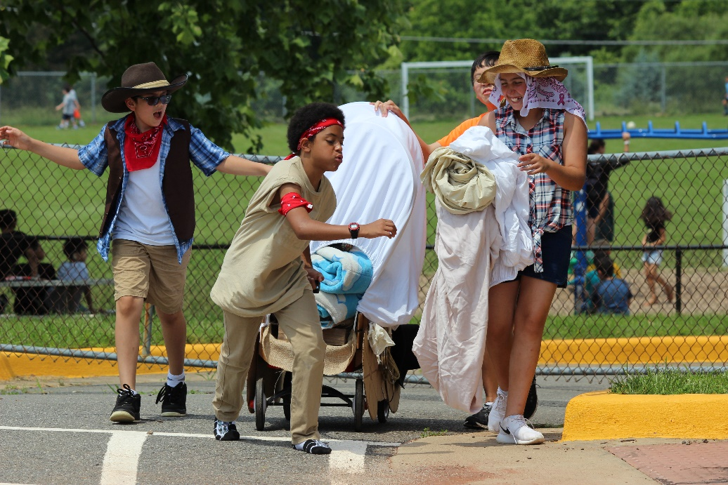
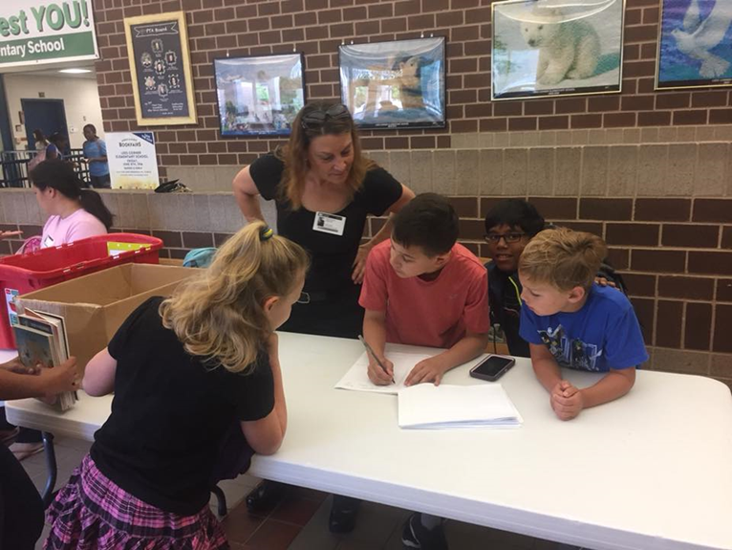
Recent Events
Western Day and Book Swap

Slide 11
Upcoming Events
TUESDAY: Chalk Walk, Kickball
WEDNESDAY: Field Day, Classroom Campout
THURSDAY: 6th Grade Luncheon, SURF
FRIDAY: Graduation (broadcast via Facebook Live) Email name to Joanne Fulmer at jsf418@gmail.com and request membership on the LCES PTA group Facebook page, Early Release (1:35)

Slide 12
Treasurer’s Report
Revised Budget vs Actual

Slide 13
Budget vs. Actual
Increased from $14K
Lees Corner PTA
2017 - 2018 Budget vs. Actuals
 |  |  | Revised Budget | Actuals | Variance
Sources of Income (Net)
 | Dues |  | $ 18,200 | $ 18,330 | $ 130
 | Donations |  | $ 1,000 | $ 1,986 | $ 986
 | Fundraising |  | $ 400 | $ 882 | $ 482
 |  | Hallowingo | $ 8,500 | $ 8,571 | $ 71
 |  | Spirit Wear | $ 1,000 | $ 1,413 | $ 413
 |  | Dining Days | $ 1,000 | $ 1,899 | $ 899
 |  | Loyalty Programs | $ 5,500 | $ 6,916 | $ 1,416
 |  | 6th Grade Basketball Game | $ 3,700 | $ 4,292 | $ 592
 | Extra Curricular Activities
 |  | Overtime Athletics | $ 3,700 | $ 6,249 | $ 2,549
 |  | After School Programs | $ 500 | $ 710 | $ 210
 |  | Book Fair | $ 3,000 | $ 3,397 | $ 397
Total Sources of Income |  |  | $ 46,500 | $ 54,643 | $ 8,143
 |  | Balance Brought Forward from PY | $ 28,750
Total Source of Income (including PY Funds) |  |  | $ 75,250 | $ 54,643 | $ 8,143
* Balance in reserve account $23,810

Slide 14
Budget vs. Actual
Expenses
 | Fundraising
 |  | Membership | $ 300 | $ 521 | $ 221
 |  | Hallowingo | $ 4,200 | $ 4,105 | $ (95)
 | Total Fundraising Expense |  | $ 4,500 | $ 4,626 | $ 126
 | Committee
 |  | Cultural Arts | $ 3,700 | $ 3,645 | $ (55)
 |  | Music | $ 1,000 | $ 1,200 | $ 200
 |  | Library Enrichment | $ 4,000 | $ 3,397 | $ (603)
 |  | Special Education | $ 5,000 |  | $ (5,000)
 |  | After School Clubs (Lego Robotics) | $ 1,500 | $ 445 | $ (1,055)
 |  | Grounds Beautification | $ 2,000 | $ 2,000 | $ -
 |  | Outdoor Classroom Maintenance | $ 2,000 |  | $ (2,000)
 |  | 6th Grade Basketball Game | $ 2,000 | $ 900 | $ (1,100)
 |  | 6th Grade Luncheon | $ 3,000 | $ 1,025 | $ (1,975)
 |  | Teacher Appreciation | $ 3,500 | $ 2,085 | $ (1,415)
 | Total Committee Expenses |  | $ 27,700 | $ 14,697 | $ (13,003)
Reduced from $4K

Slide 15
Budget vs. Actual
 | Program
 |  | Computing | $ 6,300 | $ 6,200 | $ (100)
 |  | STEAM program | $ 7,000 | $ 4,778 | $ (2,222)
 |  | School Outings/Field Trips | $ 8,100 | $ 3,875 | $ (4,225)
 |  | Periodicals | $ 5,700 | $ 5,768 | $ 68
 |  | Physical Education & Health | $ 2,700 | $ 2,476 | $ (224)
 |  | Teacher Training | $ 4,500 | $ 4,411 | $ (89)
 |  | Positive Behavior (PBIS) | $ 900 | $ 403 | $ (497)
 | Total Program Expenses |  | $ 35,200 | $ 27,912 | $ (7,288)
 | Other |  | $ - |  | $ -
 |  | Gifts Given | $ 300 |  | $ (300)
 |  | Principal Flex Fund | $ 1,000 | $ 1,087 | $ 87
 |  | Teacher Stipends | $ 2,500 | $ 2,500 | $ -
 | Total Other Expenses |  | $ 3,800 | $ 3,587 | $ (213)
 | Overhead
 |  | Admin & Supplies | $ 900 | $ 778 | $ (122)
 |  | Insurance | $ 350 | $ 298 | $ (52)
 |  | Bank Charges | $ 1,000 | $ 634 | $ (366)
 |  | PTA Dues | $ 1,300 | $ 1,168 | $ (132)
 |  | Tax Preparation | $ 500 |  | $ (500)
 | Total Overhead Expenses |  | $ 4,050 | $ 2,879 | $ (1,171)
Total Expenses |  |  | $ 75,250 | $ 53,700 | $ (21,550)
Net Use of Funds |  |  | $ (0) | $ 943 | $ 29,693
Revenues exceeded expenditures by $943.00
Notes:
-Hoping for most budget requests to come in by August so the budget can be set by September.
-Submit a request and the Board will determine which line item the request will fall under.
-Q: How are funding requests prioritized by the Board?
--A: Line items we have already will be a start (teacher training, assemblies, PE / health).
--A: No priority other than the priorities of the PTA – serve max number of teachers / student / staff – serving a single classroom would be a lower priority.
New budget approved.

Slide 16
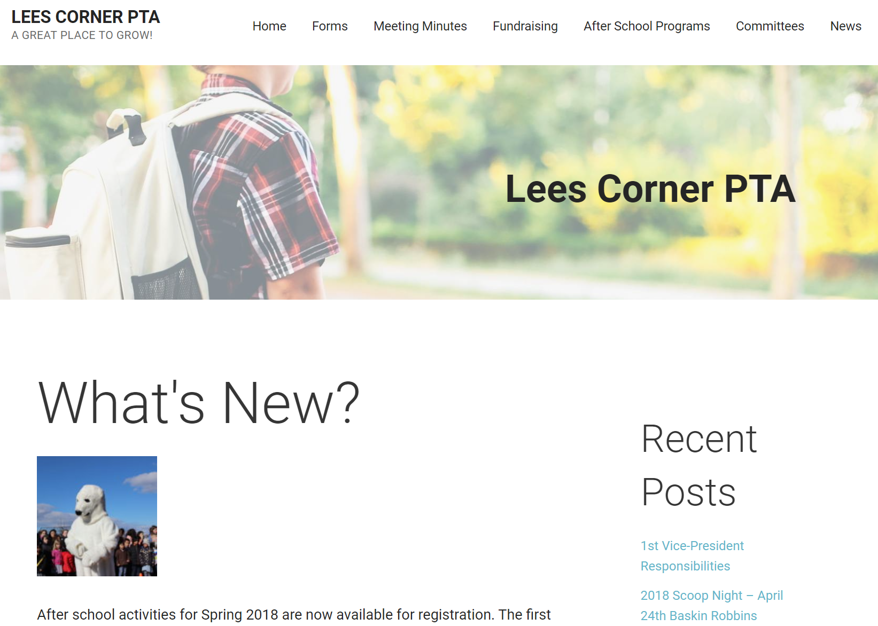
Resources
Please visit www.leescornerpta.net
Meeting materials will be posted on the home page in the next few days, including the link for the recorded live stream.
Join our Facebook group! It is a closed group so only the school community can join and posts are not available to the general public. https://www.facebook.com/groups/673851072716338/

Slide 17
Principal’s Report
Notes:
-Thanks to teachers and parents for coming out.
-Thanks to volunteers for all of the hours they put in.
-Students believe their writing skills have increased this year.
-Security cameras have been installed.
-Sixth grade promotion will be outside on Friday. Good weather expected.
-Test results came back. Scores are in the 90s! Specifics when we come back in August.
-All 41 classrooms have (double HDMI) projectors.

Slide 18
Teacher Presentation
Mrs. Carter and Mrs. McLaughlin share about Surface Pro tablets
Please watch Facebook Live video for demonstration.

Slide 19
Adjourn
Have a great summer!
Meeting adjourned at 8:02 PM.

