Slide 1
Meeting Date

Slide 2
Agenda
Principal’s Report
PTA Reports
Membership
Special Education
Effortless Fundraising
After School Programs
Upcoming Events
Treasurer’s Report
Special Presentation

Slide 3
Principal’s Report

Slide 4
Membership

Slide 5
PTA Special Education Representative

Slide 6
Fundraising Summary
Fundraising Program | Enrolled | As of Jan 2018 Actual Amount | Budget (2017-18)
Totals

Slide 7
AFTER SCHOOL ACTIVITIES - WINTER SESSION
XX Classes Offered (Season)

Slide 8
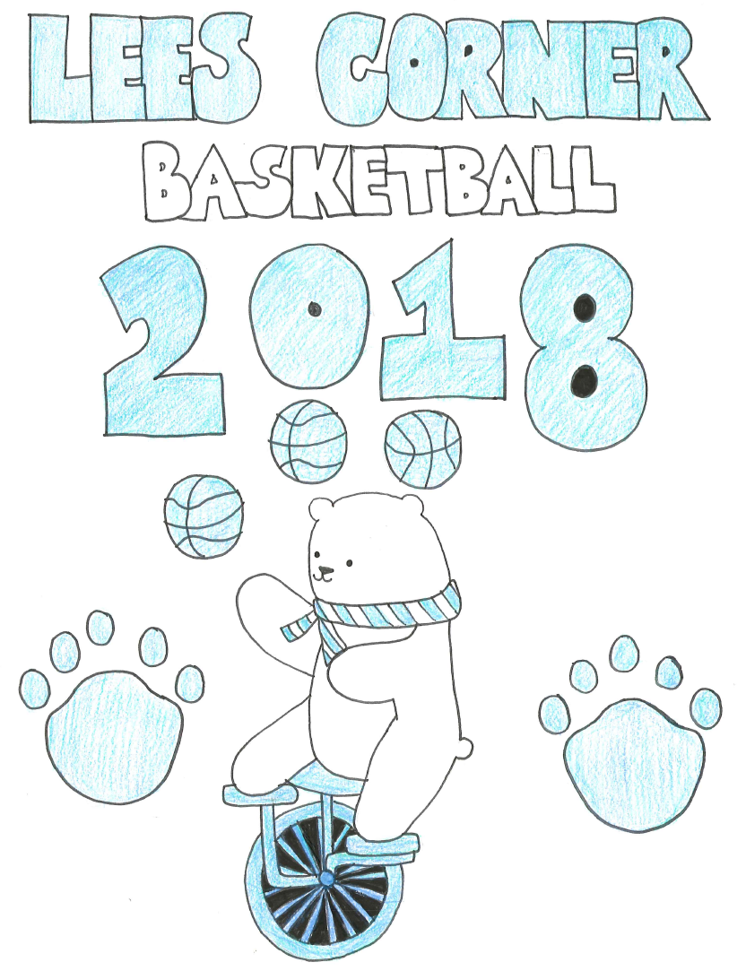
Upcoming Events

Slide 9
Treasurer’s Report Budget vs. Actual
Lees Corner PTA
2017 - 2018 Budget vs. Actuals
 |  |  | Budget | Actuals | Variance
2000 Sources of Income (Net)
 | Dues |  | $ 14,000 | $ 18,330 | $ 4,330
 | Donations |  | $ 1,000 | $ 1,000 | $ -
 | Fundraising |  | $ 400 | $ 863 | $ 463
 |  | Hallowingo | $ 7,500 | $ 8,571 | $ 1,071
 |  | Spirit Wear | $ 1,000 | $ 1,413 | $ 413
 |  | Dining Days | $ 1,000 | $ 753 | $ (247)
 |  | Grocery Receipts | $ 5,500 | $ 361 | $ (5,139)
 |  | 6th Grade Basketball Game | $ 3,700 | $ 1,034 | $ (2,666)
 | Extra Curricular Activities
 |  | Overtime Athletics | $ 3,700 | $ 6,249 | $ 2,549
 |  | After School Programs | $ 500 | $ 260 | $ (240)
 |  | Book Fair | $ 3,000 | $ 3,369 | $ 369
Total Sources of Income |  |  | $ 41,300 | $ 42,202 | $ 902
 |  | Balance Brought Forward from PY | $ 28,750
Total Source of Income (including PY Funds) |  |  | $ 70,050 | $ 42,202 | $ 902
* Balance in reserve account $25,305

Slide 10
Budget vs. Actual
4000 Expenses
 | Fundraising
 |  | Membership | $ 300 | $ 521 | $ 221
 |  | Hallowingo | $ 4,200 | $ 4,105 | $ (95)
 | Total Fundraising Expense |  | $ 4,500 | $ 4,626 | $ 126
 | Committee
 |  | Cultural Arts | $ 3,000 | $ 1,000 | $ (2,000)
 |  | Music | $ 1,000 |  | $ (1,000)
 |  | Library Enrichment | $ 4,000 |  | $ (4,000)
 |  | After School Clubs | $ 1,000 |  | $ (1,000)
 |  | Grounds Beautification | $ 2,000 |  | $ (2,000)
 |  | Outdoor Classroom Maintenance | $ 4,000 |  | $ (4,000)
 |  | 6th Grade Basketball Game | $ 2,000 |  | $ (2,000)
 |  | 6th Grade Luncheon | $ 3,000 |  | $ (3,000)
 |  | Teacher Appreciation | $ 3,500 | $ 409 | $ (3,091)
 | Total Committee Expenses |  | $ 23,500 | $ 1,409 | $ (22,091)

Slide 11
Budget vs. Actual
 | Program
 |  | Computing | $ 6,300 |  | $ (6,300)
 |  | STEAM program | $ 10,000 | $ 131 | $ (9,869)
 |  | School Outings/Field Trips | $ 8,100 |  | $ (8,100)
 |  | Periodicals | $ 2,700 |  | $ (2,700)
 |  | Physical Education & Health | $ 2,700 | $ 549 | $ (2,151)
 |  | Leadership Development (Teacher Training) | $ 3,500 | $ 3,979 | $ 479
 |  | Positive Behavior (PBIS) | $ 900 | $ 96 | $ (804)
 | Total Program Expenses |  | $ 34,200 | $ 4,755 | $ (29,445)
 | Other |  | $ - |  | $ -
 |  | Gifts Given | $ 300 |  | $ (300)
 |  | Principal Flex Fund | $ 1,000 | $ 551 | $ (449)
 |  | Teacher Stipends | $ 2,500 | $ 2,500 | $ -
 | Total Other Expenses |  | $ 3,800 | $ 3,051 | $ (749)
 | Overhead
 |  | Admin & Supplies | $ 900 | $ 684 | $ (216)
 |  | Insurance | $ 350 |  | $ (350)
 |  | Bank Charges | $ 1,000 | $ 498 | $ (502)
 |  | PTA Dues | $ 1,300 | $ 1,168 | $ (132)
 |  | Tax Preparation | $ 500 |  | $ (500)
 | Total Overhead Expenses |  | $ 4,050 | $ 2,350 | $ (1,700)
Total Expenses |  |  | $ 70,050 | $ 16,190 | $ (53,860)
Net Use of Funds |  |  | $ (0) | $ 26,012 | $ 54,762

Slide 12
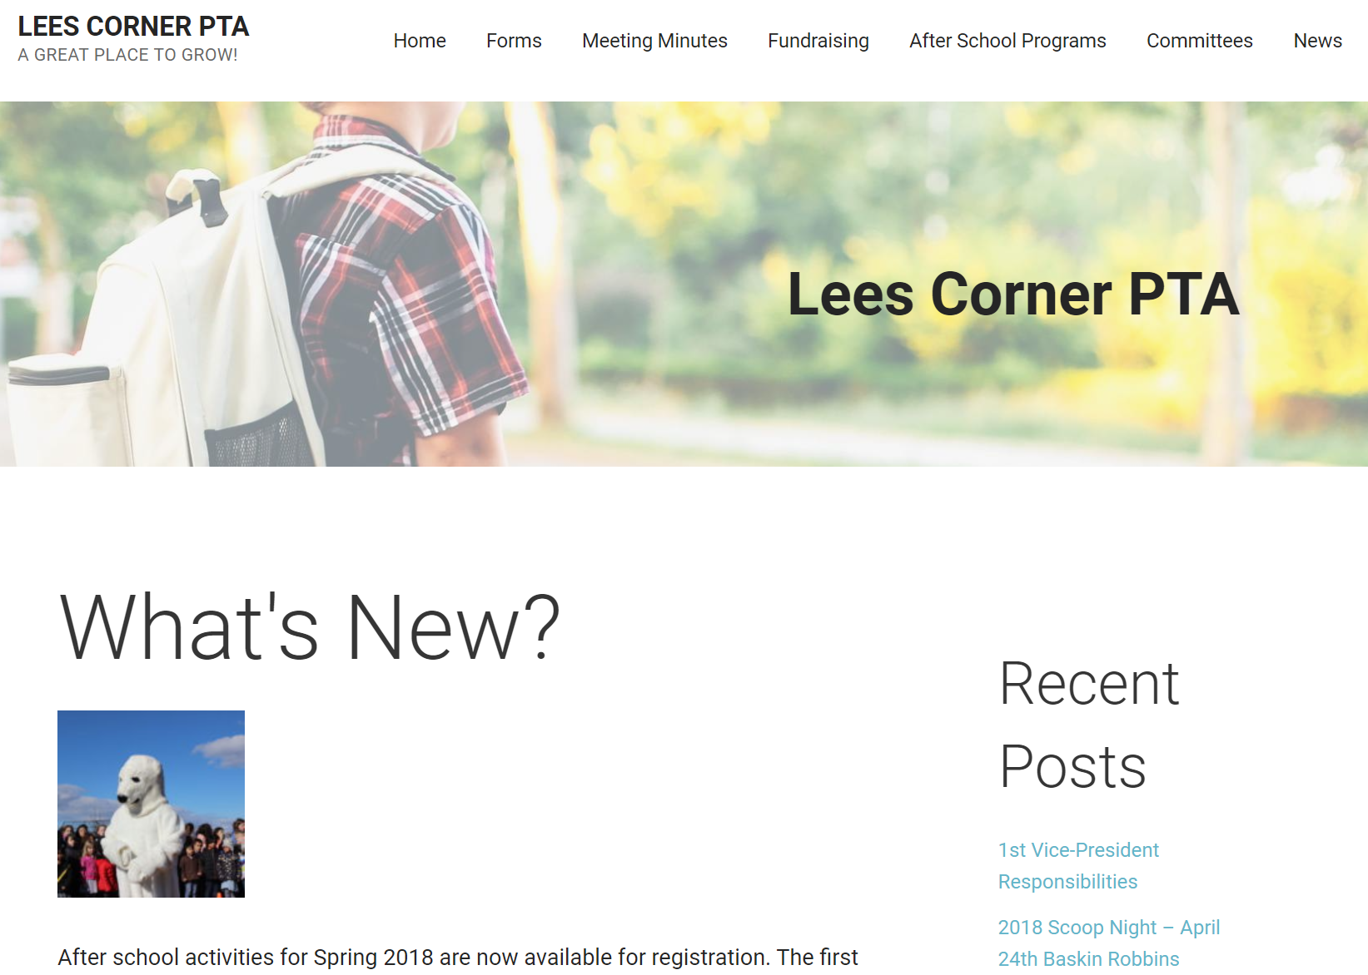
Resources
Please visit www.leescornerpta.net
Meeting materials will be posted on the home page in the next few days, including the link for the recorded live stream.
Join our Facebook group! It is a closed group so only the school community can join and posts are not available to the general public. https://www.facebook.com/groups/673851072716338/

Slide 13
Adjourn
Next meeting: Date
Same time, same place!

